Slide 1
Software quality models & Quality in the software process
45426: Teste e Qualidade de Software
Ilídio Oliveira
v2025-12-17

Slide 2
Learning objectives
Define software quality and recognize the elements of software quality.
Explain the structure of ISO/IEC 25010:2011 Quality Model.
Distinguish between internal and external quality factors and give examples.
Explain the principles of agile testing
Distinguish Agile Testing from Continuous testing
Explain the insertion of QA in the software engineering process according to the TDD
Explain the TDD cycle and argue in favor its adoption
Which tools can be used to address que “quality dilemma”?

Slide 3
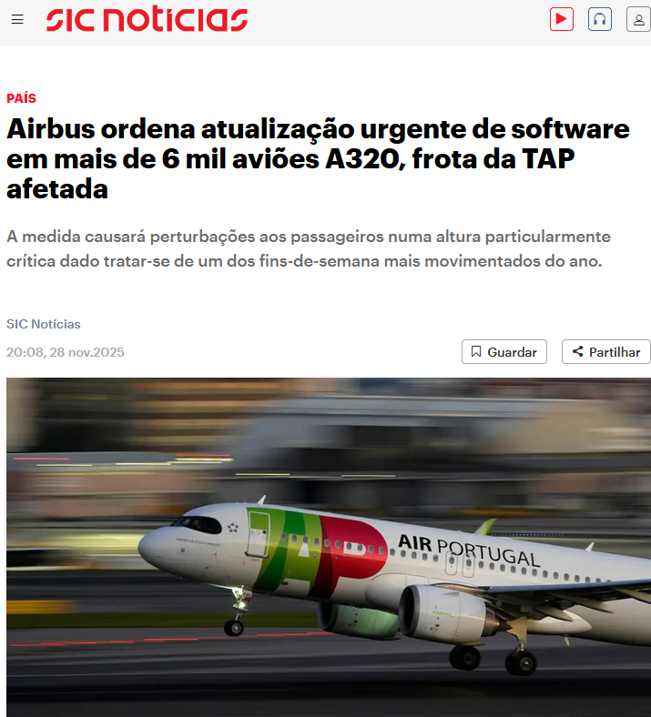
Elements of software quality
We can recognize the lack of quality...
Can we be systematic about the elements of software quality?
Goal: shift from”coding” to “engineering”

Slide 4
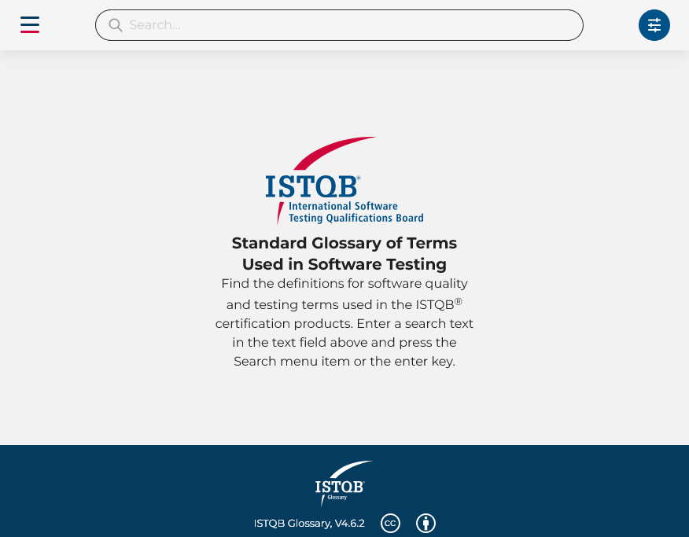
Software quality defined
ISTQB Glossary
  Quality: The degree to which a work product satisfies stated and implied requirements.
https://glossary.istqb.org/

Slide 5
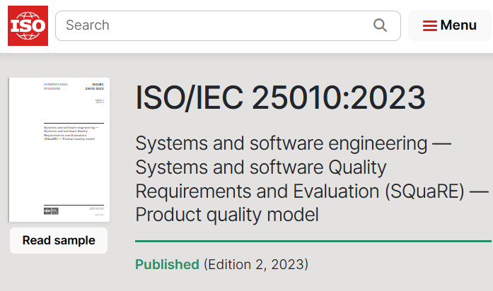
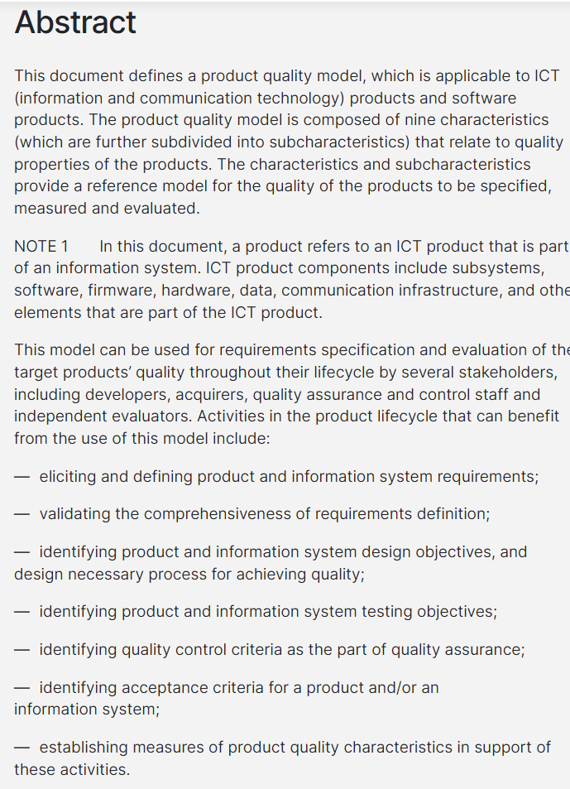
Software (product) quality defined
The degree to which a software product satisfies stated and implied needs when used under specified conditions
(ISO/IEC 25010:2023 Systems and software engineering--Systems and software Quality Requirements and Evaluation (SQuaRE)--System and software quality models)

Slide 6
Software quality models
The quality model is the cornerstone of a product quality evaluation system. The quality model determines which quality characteristics/factors will be considered when evaluating the properties of a software product. Factors do not necessarily lend themselves to direct measurement

Slide 7
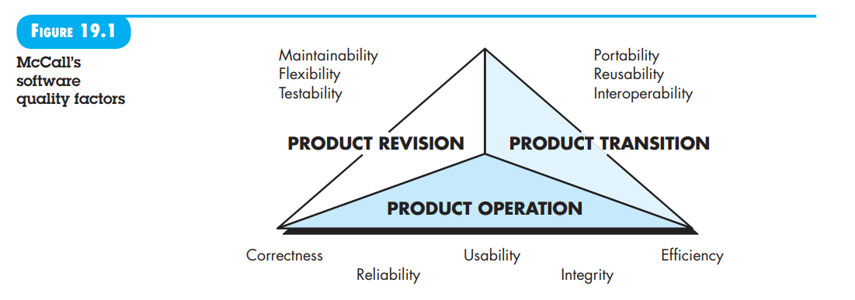
McCall’s software quality factors [McC77]
Useful categorization of factors that influence software quality. These software quality factors, focus on three important aspects of a software product: its operational characteristics, its ability to undergo change, and its adaptability to new environments.

Slide 8
ISO/IEC 25010 Components
The ISO/IEC 25010 Software Quality Model, developed by the International Organization for Standardization (ISO) and the International Electrotechnical Commission (IEC), provides a systematic approach to assessing and measuring software quality.
ISO/IEC 25010 organizes software quality into two dimensions:
Product quality refers to the inherent characteristics of the software product itself. It encompasses functionality, reliability, usability, efficiency, maintainability, and portability. These characteristics are evaluated based on predefined criteria and metrics to assess how well the software meets its intended quality requirements and objectives.
Quality in use focus the software product effectiveness and satisfaction in real-world usage scenarios. Quality in use is subjective and context-dependent. It requires gathering feedback from users and stakeholders to understand their experiences, preferences, and needs.

Slide 9
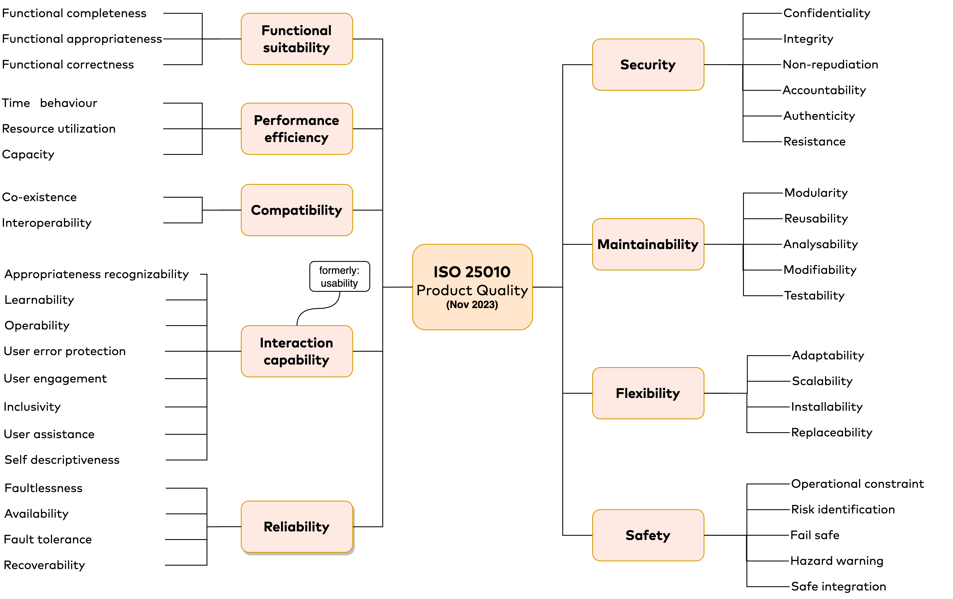
ISO/IEC 25010:2023 – Product quality model
https://blog.codacy.com/iso-25010-software-quality-model
Functional quality/factors are just a part of the story…
Notes:
1. Functional Suitability
Completeness, Correctness, Appropriateness.
2. Performance Efficiency
Time Behaviour, Resource Utilization, Capacity.
3. Compatibility
Co-existence, Interoperability.
4. Interaction Capability (formerly "Usability")
Refocuses on the attributes of the tool, not the outcome of the user.
Appropriateness Recognizability: Can users tell if this tool fits their needs?
Learnability: Is it easy to learn?
Operability: Is it easy to control?
User Error Protection: Does the system prevent mistakes?
User Engagement: Is the interface inviting?
Inclusivity: Can people with diverse backgrounds use it?
Self-descriptiveness: Does the product explain itself?
5. Reliability
Maturity, Availability, Fault Tolerance, Recoverability.
6. Security
Confidentiality, Integrity, Non-repudiation, Accountability, Authenticity.
7. Maintainability
Modularity, Reusability, Analyzability, Modifiability, Testability.
8. Flexibility (formerly "Portability")
Renamed to reflect ability to adapt to new requirements, not just environments.
Adaptability, Installability, Replaceability, Scalability.
9. Safety (New Top-Level Characteristic)
Crucial for Life-Critical Systems.
Operational Constraint: Does it operate within safe limits?
Risk Identification: Can it identify hazardous events?
Fail Safe: Does it fail into a safe state?
Hazard Warning: Does it warn users of risks?

Slide 10
Quality in use
Even if the code is perfect, the software fails if the user cannot achieve their goals in the real world.
Key Metrics:
Effectiveness: Can users achieve specific goals with accuracy?
Efficiency: Resources expended in relation to results.
Satisfaction: Usefulness, trust, and pleasure.
Freedom from Risk: Mitigation of economic, health, or safety risks.
Context Coverage: Completeness in both specified and unspecified contexts.

Slide 11
Tests management

Slide 12
Practices of SQA
Testing
Software configuration management
  Versions management
Code improvement
  Reviews, shared practices, static analysis,…
Continuous integration/Continuous Delivery
Formal methods (out of scope for our course)
…

Slide 13
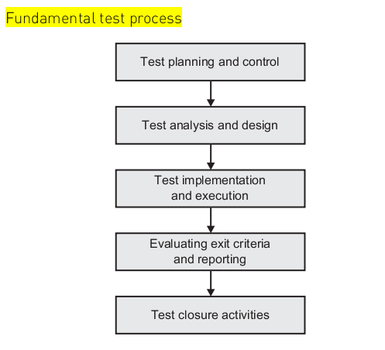
Testing as a (parallel) process
Testing methodology should answer:
  What to test , how to test, when to stop, who does what

Slide 14
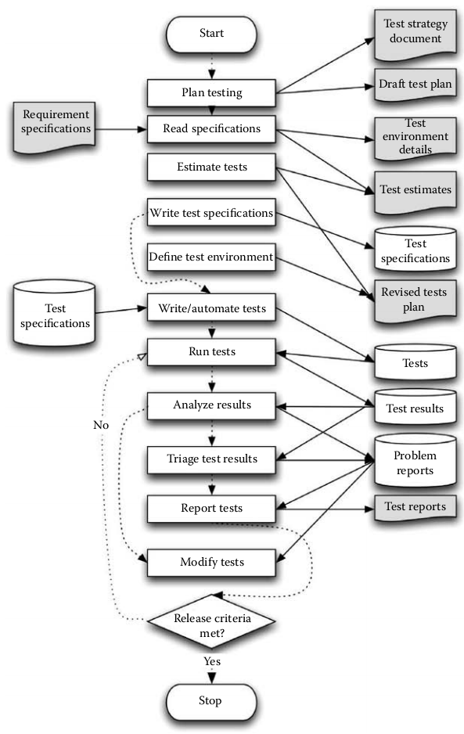
Detailed test process activities
P. Farrell-Vinay, Manage Software Testing

Slide 15
Tests in the (agile) engineering process

Slide 16
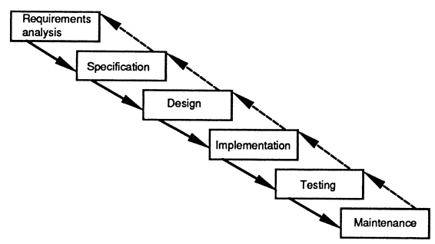

“Classical” engineering approach: Waterfall model

Slide 17
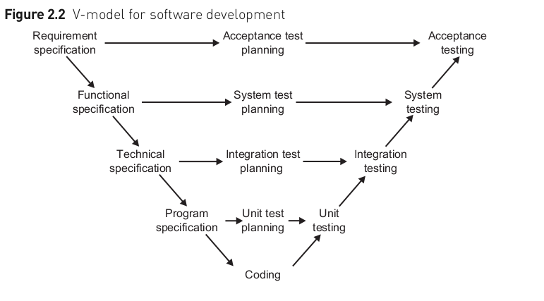
Test lifecycle and sw development lifecycle: the V-Model approach
Testing activities
Products
Notes:
Test planning begins early
Each phase includes planning for test activities
Testing for correctness and completeness (of docs) before advancing.
Each activity on the left and a counterpart test activity on the right
Testers participate in reviewing document

Slide 18
Evolutionary development “conquers” the product along short development cycles
Requirements
Analysis & Design
Planning
Implementation
Management
Environment
Test
Evaluation
Each iteration produces some executable result
Deployment
Notes:
The earliest iterations address greatest risks. Each iteration produces an executable release. Each iteration includes integration and test.
Iterations help:
resolve major risks before making large investments.
enable early user feedback.
make testing and integration continuous.
focus project short-term objective milestones.
make possible deployment of partial implementations.
Iterative processes were developed in response to waterfall characteristics. With an iterative process, the waterfall steps are applied iteratively. Instead of developing the whole system in lock step, an increment (i.e. a subset of system functionality) is selected and developed, then another increment, and so on.
The selection of the first increment to be developed is based on risk, the highest priority risks first. To address the selected risk(s), choose a subset of use cases. Develop the minimal set of use cases that will allow objective verification (that is, through a set of executable tests) of the risks that you have chosen. Then select the next increment to address the next highest risk, and so on. Thus you apply the waterfall approach within each iteration, and the system evolves incrementally.

Slide 19
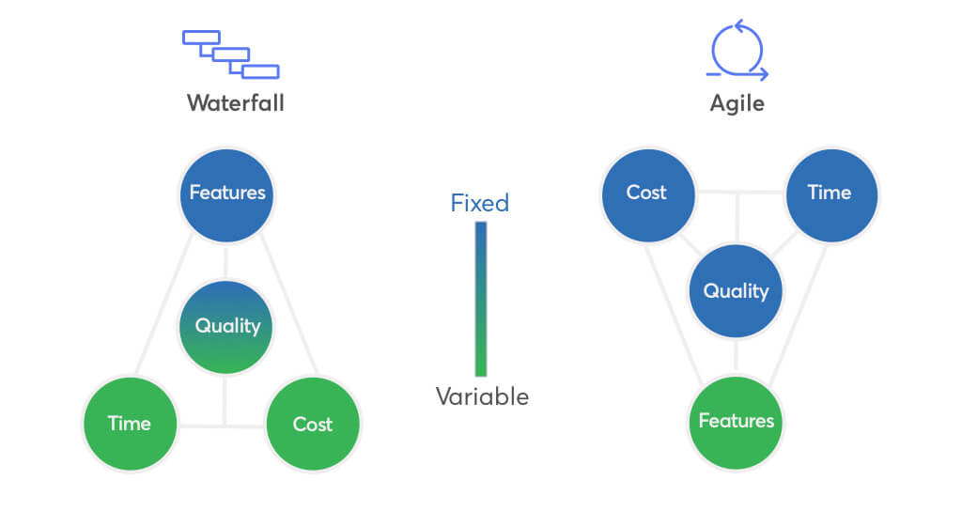
Comparing old-school and incremental approaches

Slide 20
Agile Testing
Collaborative testing practices that occur continuously, from inception to delivery and beyond, supporting frequent delivery of value for our customers. Testing activities focus on building quality into the product, using fast feedback loops to validate our understanding. The practices strengthen and support the idea of whole team responsibility for quality.
Lisa Crispin & Janet Gregory

Slide 21
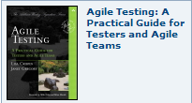
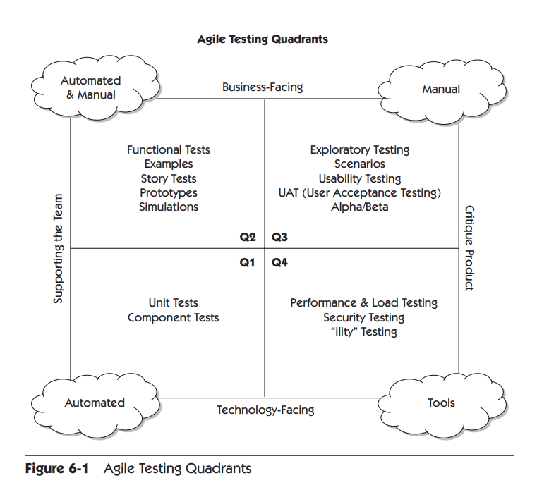
Agile testing quadrants
Confirm the product meets business expectations. Often conducted by the development team in collaboration with stakeholders; validate the business value of the software.
With agile development, fits BDD.
Feedback on user experience and exploratory testing. Typically real users working with the application.
Exploratory testing (conducted spontaneously; interact with the software in unexpected ways)
Evaluate non-functional qualities. Technology-facing tests; review the product “-ilities” (performance, security, scalability,…)
Help developers build high-quality code. Highly automated; run frequently (e.g., at each build); provide immediate feedback; often conducted by the developers themselves.
Q1 tests fits test-driven development (TDD).
https://learning.oreilly.com/library/view/agile-testing-a/9780321616944/ch06.html

Slide 22
Test-driven development (TDD)

Slide 23
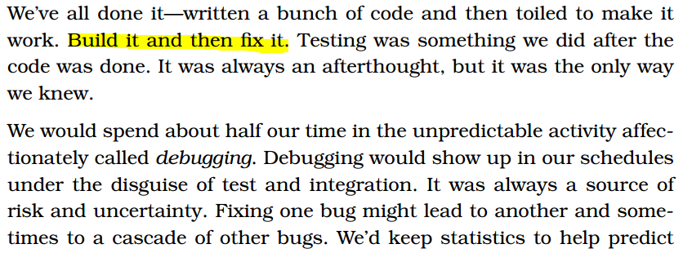

Debug Later Programming

Slide 24
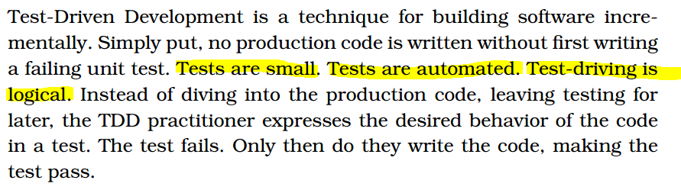
Test-driven mindset

Slide 25
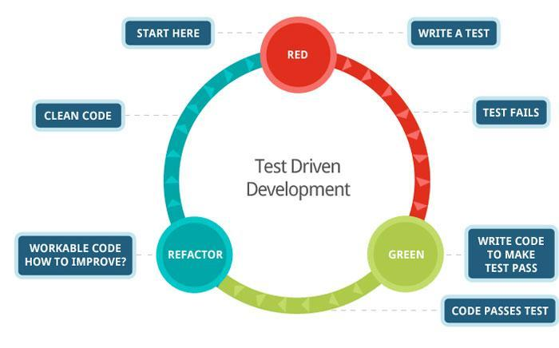
TDD: Test Driven Development

Slide 26
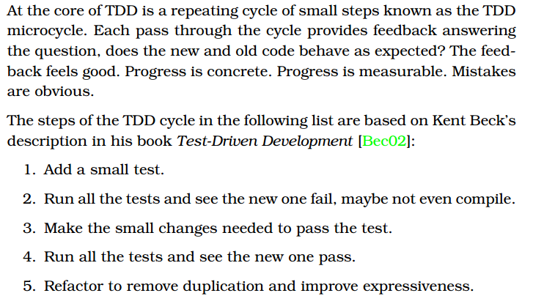

Slide 27
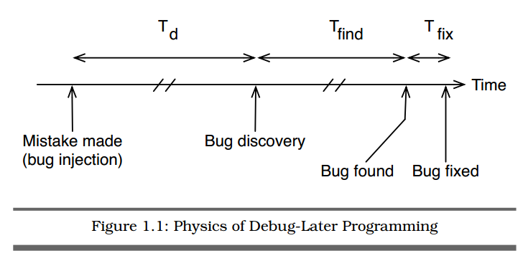
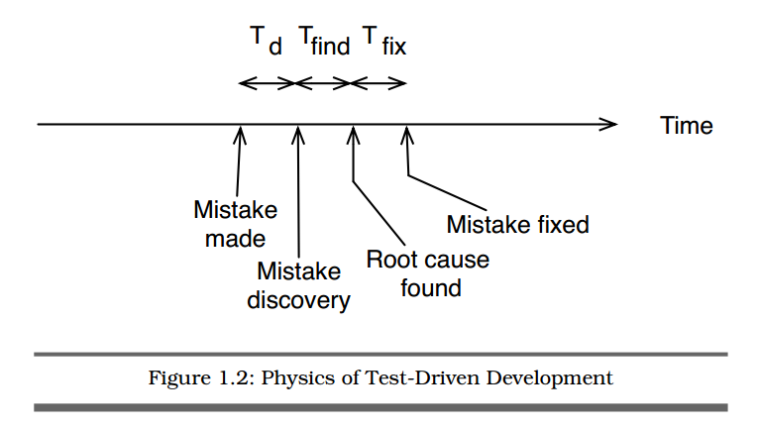

Slide 28
Acceptance test driven development (ATDD)

Slide 29
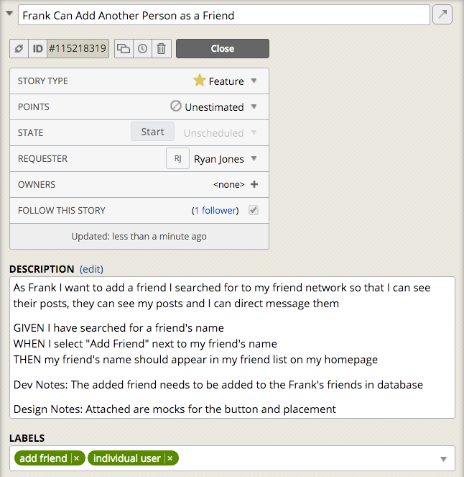
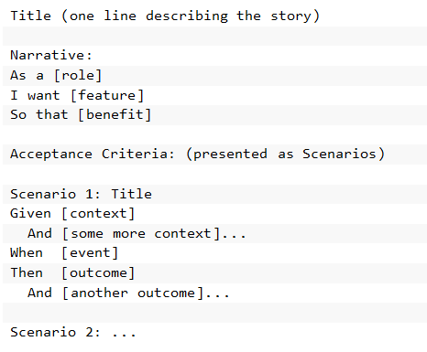
A story and tests...
→ Principles for user stories content

Slide 30
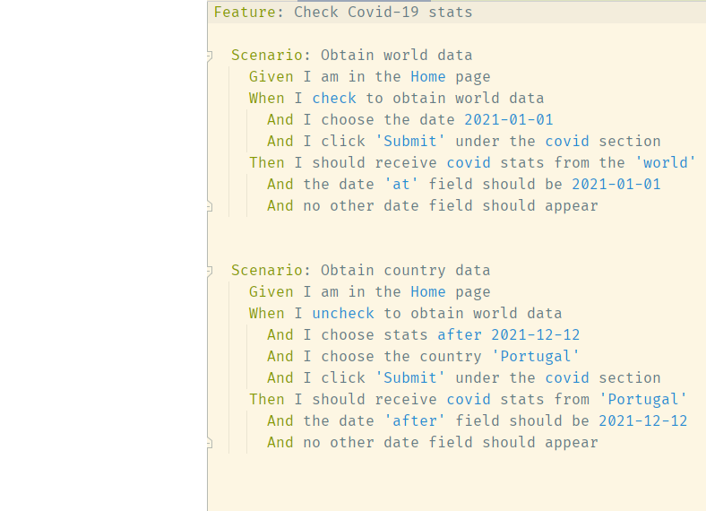
Behavior Driven Development: Given, When, Then style
Structured syntax (Gherkin) to describe a feature (for testing):
  Feature: what
  Scenario: some determinable business situation
  Given: preparation/setup (e.g.: required data)
    And…
  When: the set of actions (execute).
    And…
  Then: specifies the expected resulting state (assert).
    And…
Acceptance criteria should be executable

Slide 31
Integrate Continuous testing in the development process

Slide 32
Towards Continuous Testing
“We’re on the border between traditional testing and modern and continuous testing.
We’re moving…
  from the structure of the large, siloed Dev team with a centralized QA, and bottlenecks and delays in handoffs
  to a new structure: consists of small, autonomous and self-contained teams, which frequently ship software, use Continuous Integration tools to automate, and manage their own build environment to minimize bottlenecks.”
Practices for Continuous Testing:
Invest in continuous testing tools
  Play well with continuous integration (Git, Travis CI, GitHub Actions, Sonarqube,…)
  Opensource, documentation,…
Automate anything you can
  The more tedious tasks are the more likely to be ready for automation
Collaborate
  No silos; shared dashboards, shared ownership, Slack-like feedback on QA events
Define & publicize results
  could include test coverage, number of pass-fail builds, average response time, etc.
  “Dashboards in social areas” style of feedback
https://www.testorigen.com/key-best-practices-for-continues-testing-in-agile/

Slide 33
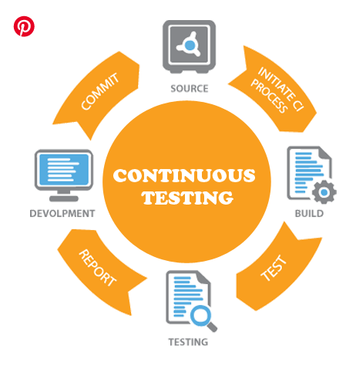
Continuous testing
Continuous Testing is an effective testing technique carried out to automate the testing process, so it happens simultaneously with the development process
Scope is vast, with the validation of the functional and non-functional requirements of the product.
Key components:
  Continuous Integration (CI)
  Continuous Delivery (CD)/test environments
  Test Automation
https://www.professionalqa.com/continuous-testing

Slide 34
Quality concerns in the Definition of Done
Definition of Done in Agile
  The development team needs to decide what Done means (DoD)
  DoD → checklist of assertions that must be true for every increment of software that is ready for deliver
DoD “properties”:
    A short, measurable checklist
    Assess shippable-readiness
    Yet, realistic…
Sample topics:
  Story is estimated
  Acceptance criteria agreed
  Code reviewed
  Acceptance Tests for Increment exist and are Automated
  Code Coverage meets required level
  Security Checks Pass on Increment
  Increment meets agreed UX standards
  Increment has been demonstrated to PO

Slide 35
The quality dilema

Slide 36
Quality dilema: when good is good enough?
If you produce a software system that has terrible quality, you lose because no one will want to buy it.
If on the other hand you spend infinite time, extremely large effort, and huge sums of money to build the absolutely perfect piece of software, then it's going to take so long to complete and it will be so expensive to produce that you'll be out of business anyway. Either you missed the market window, or you simply exhausted all your resources.
So people in industry try to get to that magical middle ground where the product is good enough not to be rejected (…) but also not the object of so much perfectionism (…) that it would take too long or cost too much to complete.
B. Meyers
More resources, time to market?,…
Faster, reputation risks,…
http://www.artima.com/intv/serious2.html

Slide 37

“I worry that one day all of humanity will be maintaining code of our forefathers... think of the children!”
@stackexchange

